Slide 1


Chapter 14
Understanding Applications in a Virtual Machine
Virtualization Essentials

Slide 2
Chapter 14 Objectives
Examine application performance in virtual environments
Understand how applications are deployed in virtual machines
Examine how applications are packaged for virtual environments
2

Slide 3
Application Deployment
Applications are the reason for servers
Application owners reluctant to virtualize because of perceived risk (“Change is risk”)
Virtualization offers benefits in agility, flexibility, scalability, and security
At worst case, same installation and deployment model in physical or virtual, though virtual offers options
Always gather metrics
No realistic way to gauge performance without measurable data
3

Slide 4
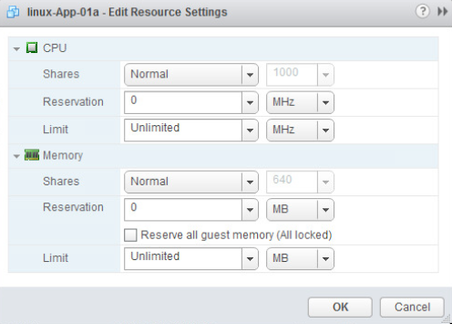
Controlling VM Resources
Three parameters to control resources
Applies to CPU and memory
Shares
Relative to the other virtual machines
Reservations
Guaranteed minimum needed
Limits
Upper limit that can be allocated
4

Slide 5
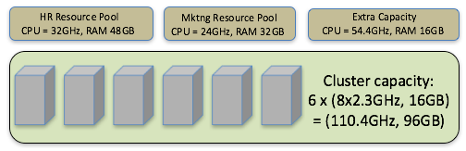
Resource Pools
Aggregated CPU cycles and memory that are reserved for a group of virtual machines or users
Can be applied to a single host or across a cluster
Can be dynamically altered
5

Slide 6
Other Strategies
Automated live migration can provide load balancing to prevent contention in a single host
Automated storage migration can do the same when storage contention is possible
VM-affinity
Guarantees that two virtual machines will always be on the same host
Anti-affinity guarantees they never will
Quality of Service (QOS) capabilities
Storage IO Control and Network I/O Control help ensure applications receive adequate resources
6

Slide 7
Application Architecture in a Virtual Environment
Virtual firewalls can protect VMs from malicious intrusions
VMs can be isolated from physical networks using virtual networking
Virtual advantages are page sharing for better resource utilization, templates and clones for faster and more accurate deployment, live migration to minimize planned downtime
7

Slide 8
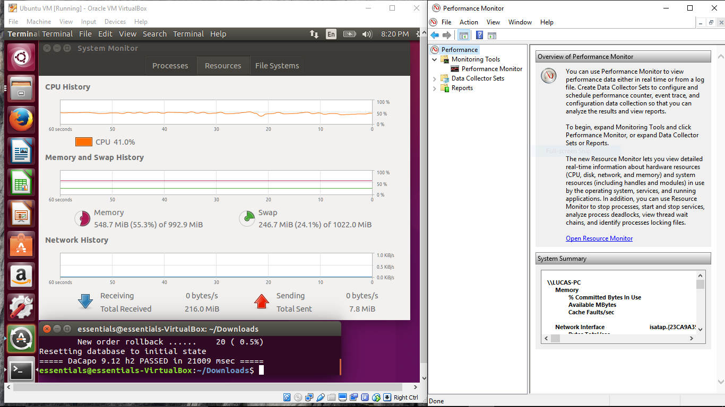
Virtual Application Performance
Context is key: Understand where the bottleneck is
Is it in the physical environment or as a result of an under-allocated resource in the VM?
Dynamic configuration alterations are possible in a virtual environment
Metrics, metrics, metrics
Measure early and often
8

Slide 9
Virtual Appliances and vApps
Virtual appliances are prebuilt and pretested virtual machines that already contain everything they need to deploy their application
Some are specially architected with optimized operating systems that deliver only what the application requires
Faster to deploy/upgrade since the entire appliance is replaced when a patch or update is available
vApps are packages of VMs that make up an entire application deployment
9

Slide 10
Chapter 14 Summary
In any environment, performance metrics are crucial to understanding how well an application is servicing its users
Proper configuration can provide applications in virtual machines with performance that meets or exceeds physical servers
Applications can be delivered as prepackaged virtual machines or as optimized virtual appliances to further reduce costs and deployment times
With increased agility, flexibility, security, and availability for applications, virtualization is the platform for the cloud
10

